Slide 1
Registration Process
Team members register AFTER captain sets up team online
1. Register online www.cbsd.org/relayforlife
Scroll all the way to the bottom
2. Complete permission slip and pay $10 fee online

Slide 3
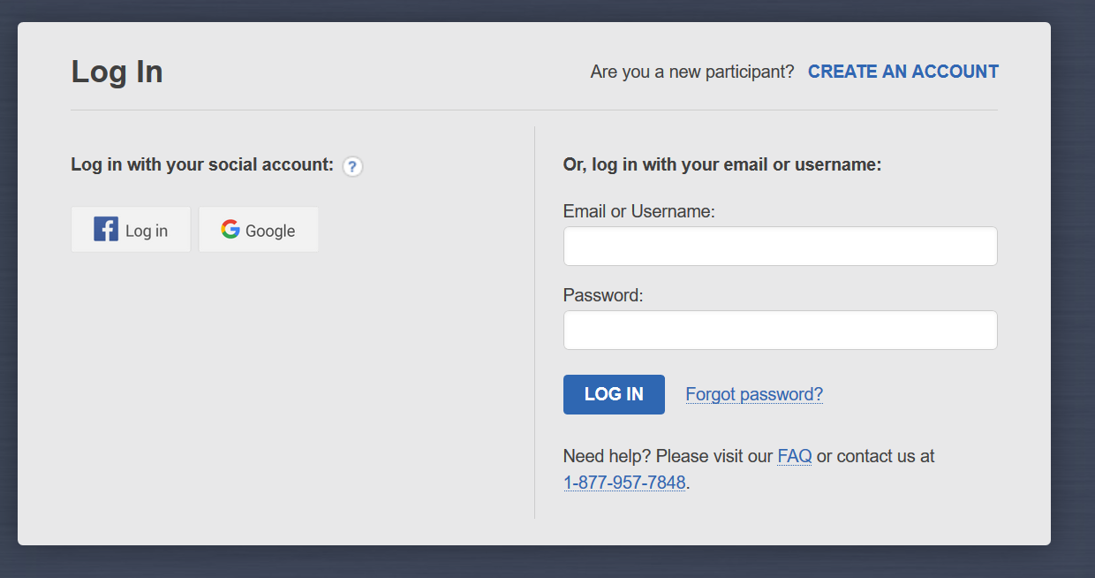

Slide 4
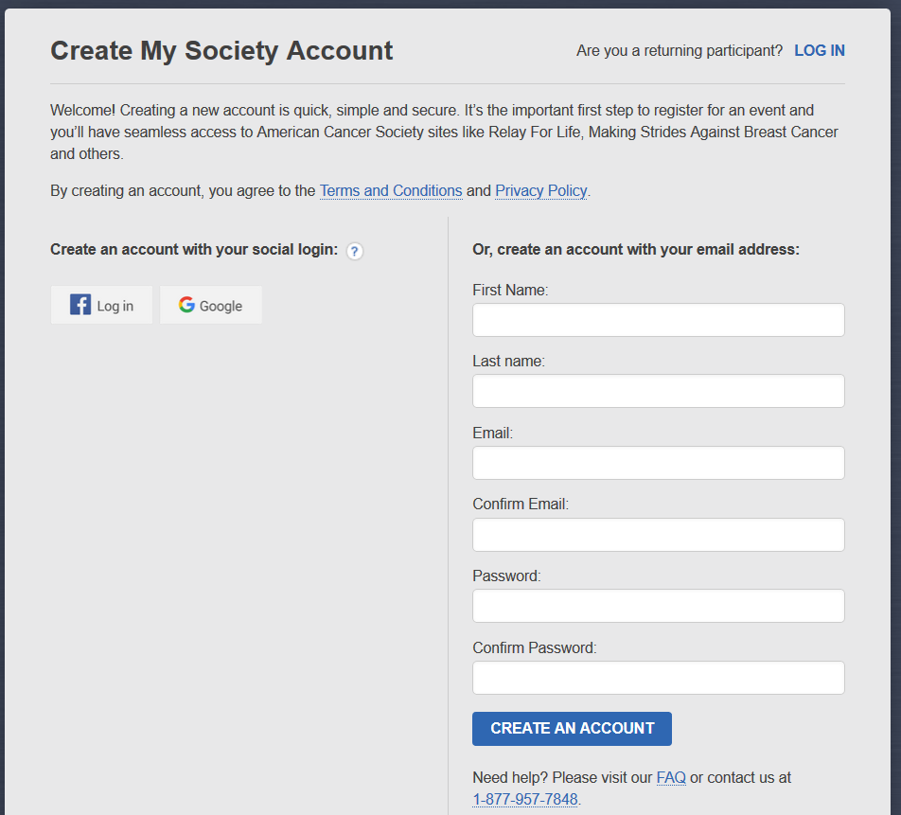
**Write down your password because we can’t get it for you!

Slide 5
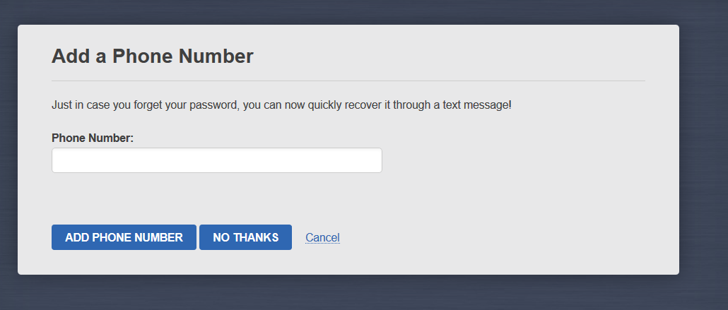

Slide 6
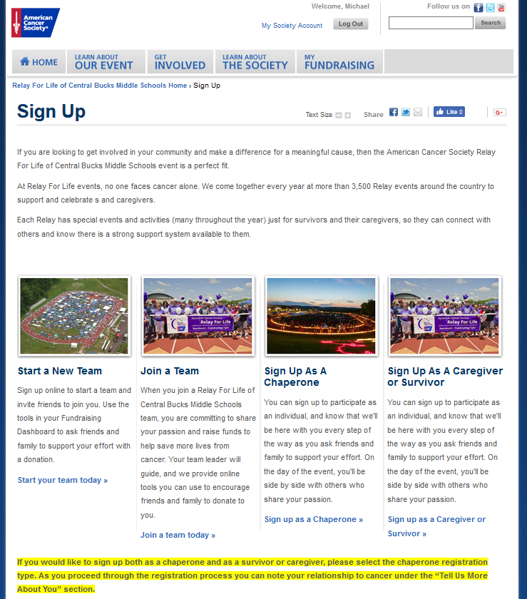
Team Members

Slide 7
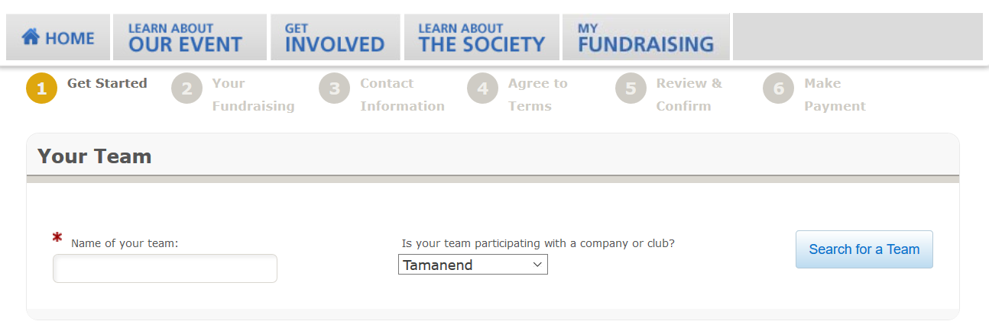

Slide 8
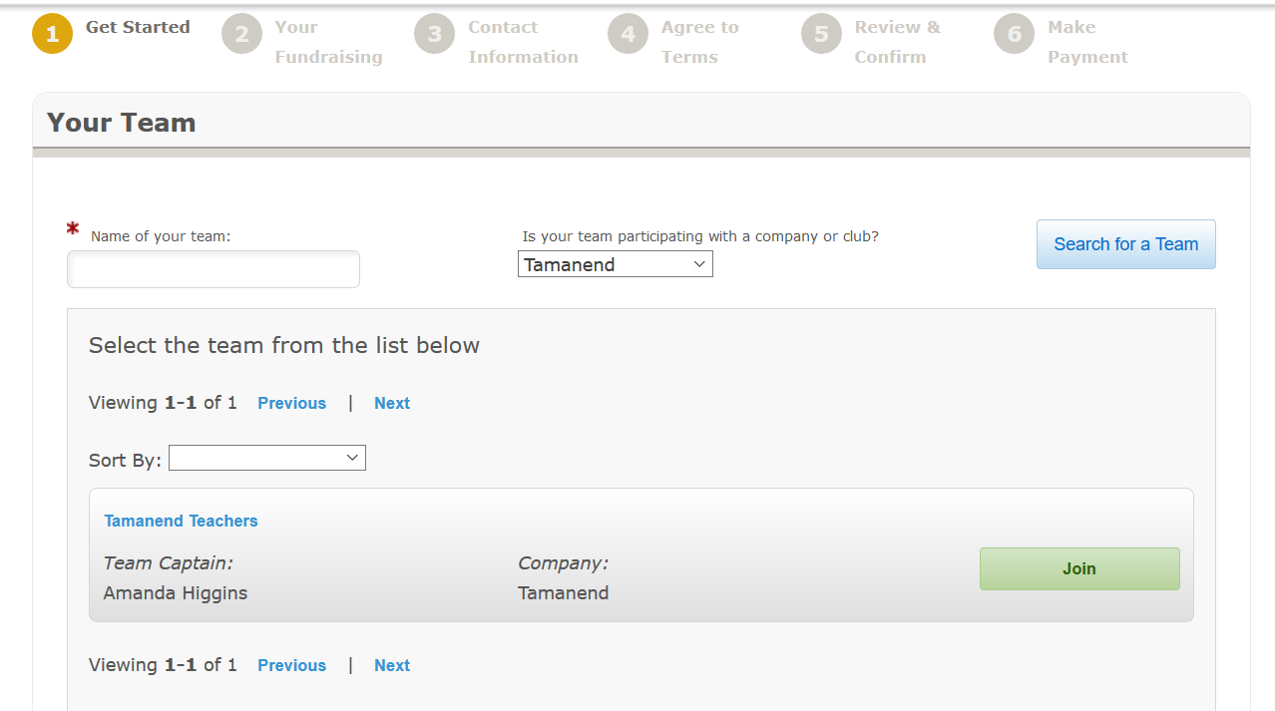

Slide 9
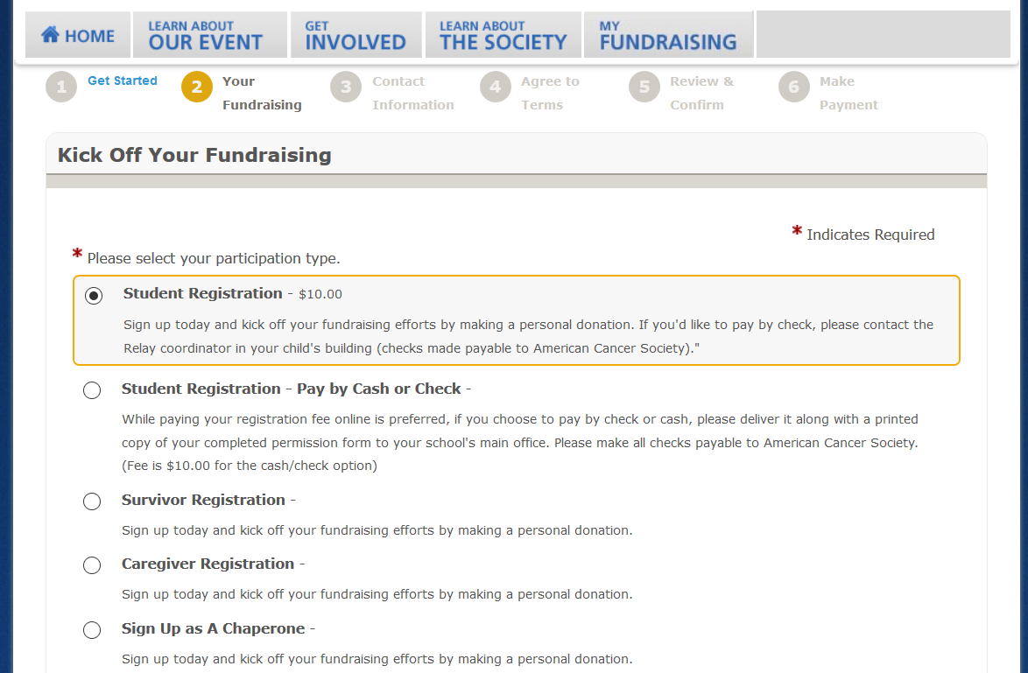

Slide 10
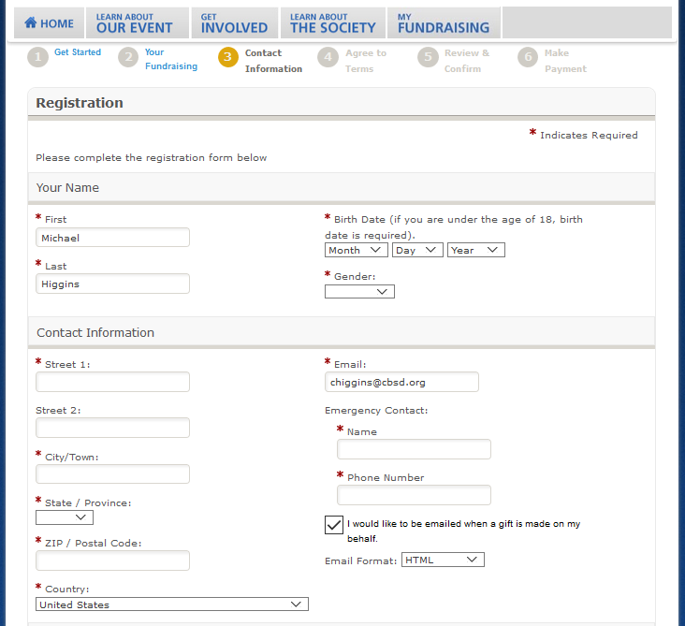

Slide 11
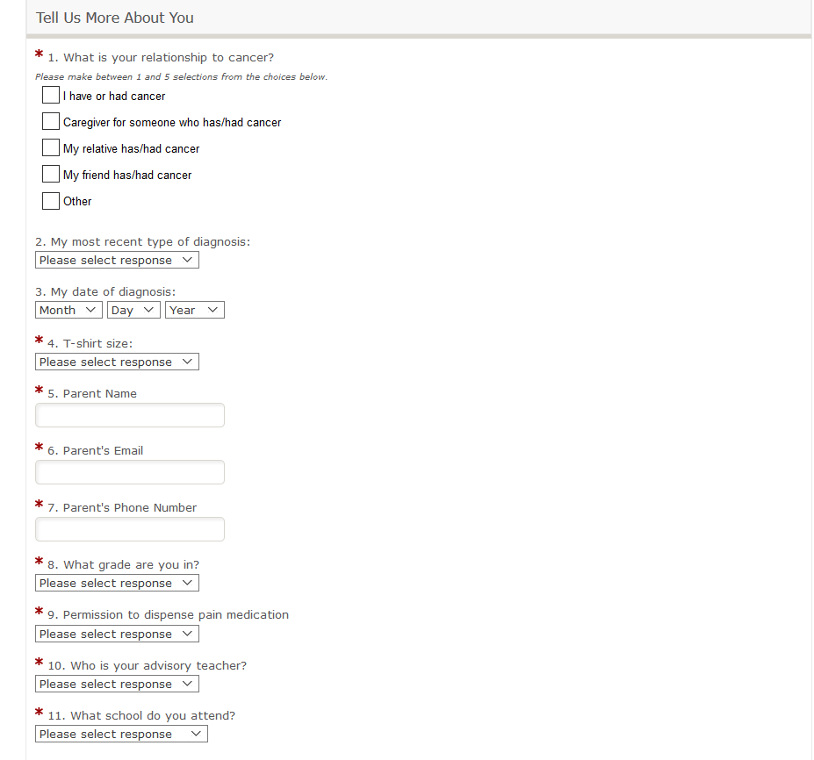

Slide 12
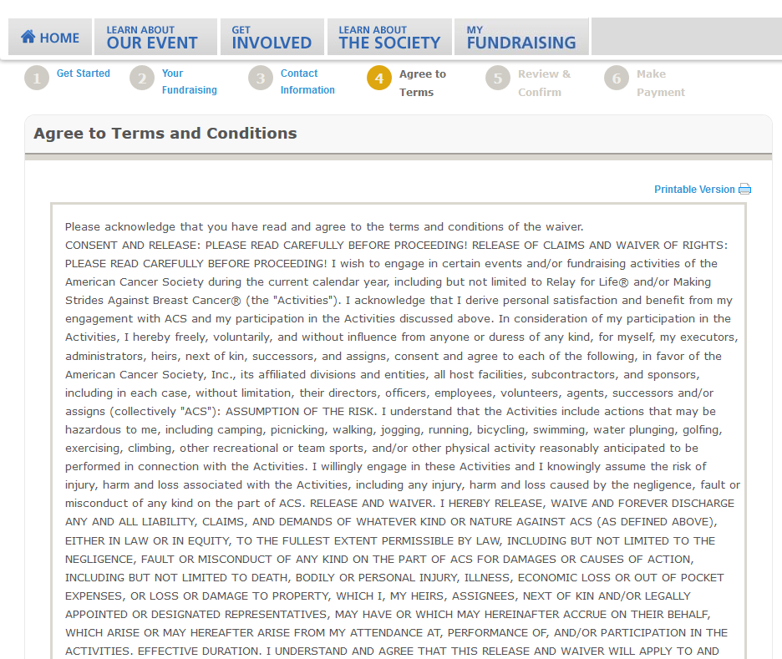

Slide 13
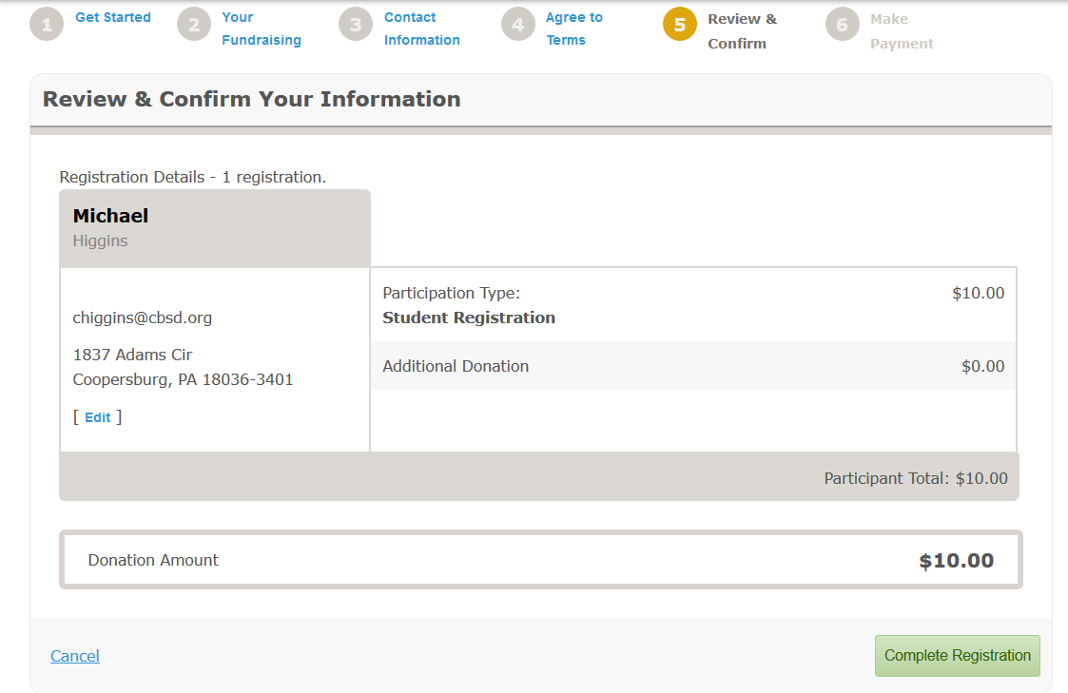

Slide 14
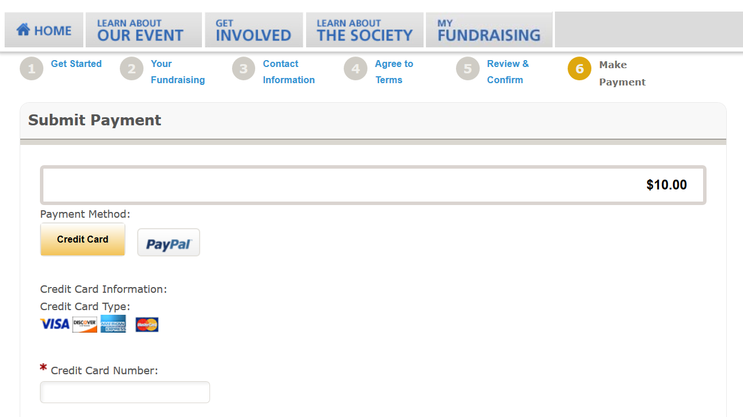

Slide 15
Registration Issues
If you are unable to pay online, bring permission slip and $10 check (to American Cancer Society) to ADVISORY on Friday, March 22.
This is an absolute deadline!

Slide 16
You’re not done yet!!!

Slide 17
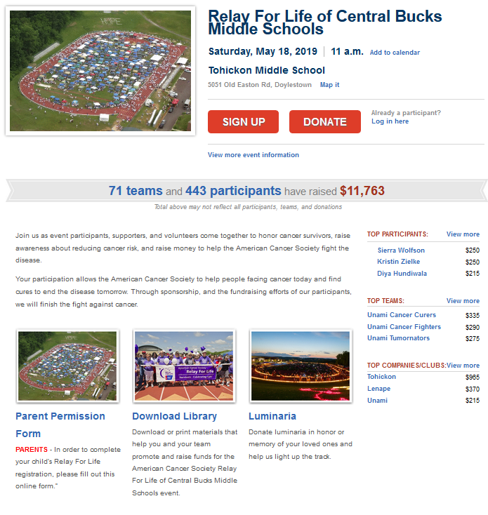
Permission Slip should arrive in Parent e-mail…they sign electronically.

Slide 18
Registration CLOSES on March 22.
We cannot register you after this date!!!

Slide 19
Important Dates
Tuesday, March 12: Captain Meeting to set up teams. (Advisory, room 230)
Friday, March 22: Absolute registration deadline
Mid April: Chaperone schedule due
Tues/Wed April 23 & 24: Mandatory Chaperone meeting at Tohickon
One week before Relay: Absolute deadline for $50

